Slide 1
Heated + Power Seats in 2024 F150 STX - Part 2
Swapping in a XLT HVAC module, wiring, and FORSCAN configuration

Slide 2

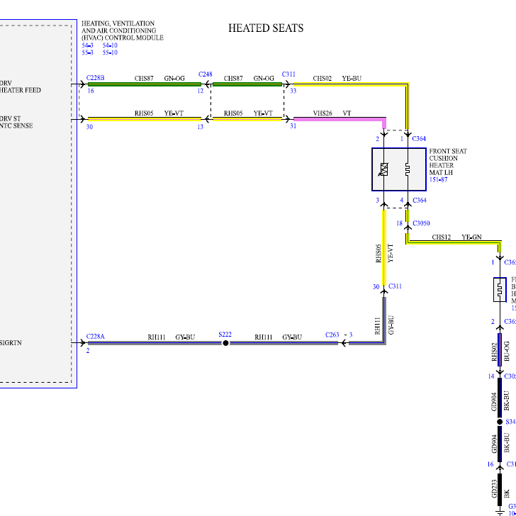

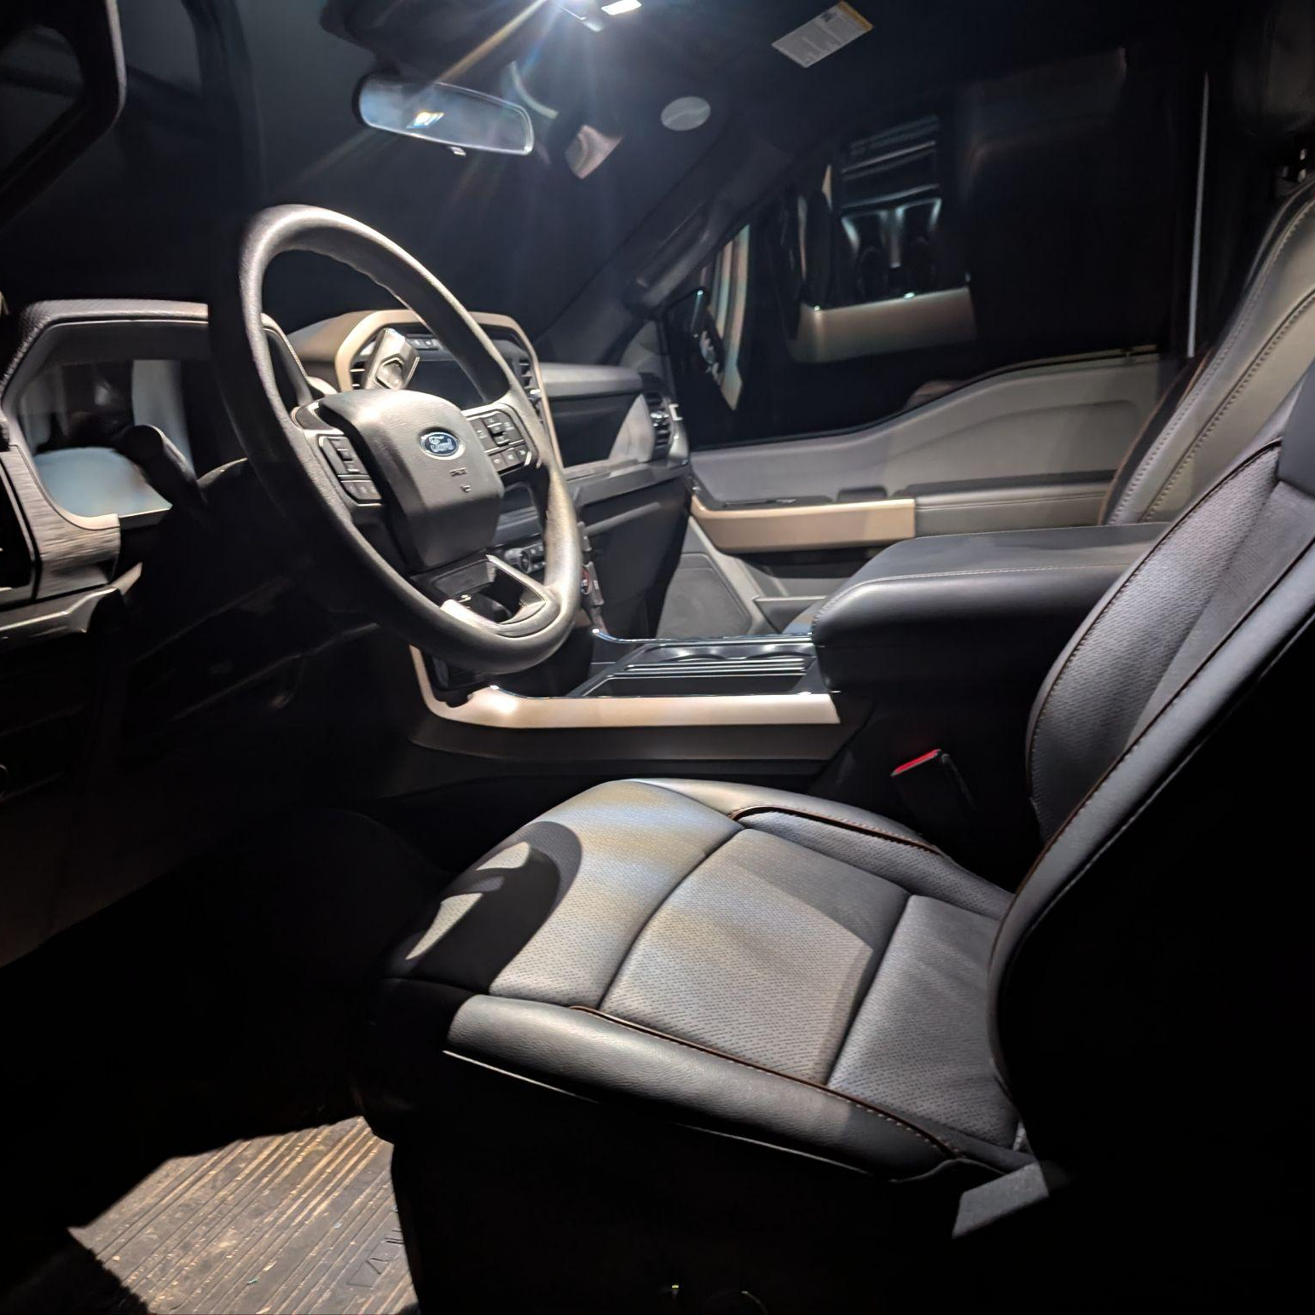
Game Plan
STEP
01
Materials Needed
STEP
02
Review factory wiring Diagrams
STEP
03
FORScan changes
STEP
04
Installation with Tips & Tricks

Slide 3

Materials Needed
Gen 14 F150 Power + Heat Seat Frames + Wiring (XLT)
Gen 14 F150 HVAC module from XLT
Wire
14 Gauge
16 Gauge
22 Gauge
Pins/Terminals
Seats (C312/C311) (3 male/female pin/terminals per seat)
KU2Z-14S411-SA
KU2Z-14S411-TA
(Or the signal wires from your seats you swapped)
HVAC (C228B) 2 terminals each, 6 total
**Mouser MX150 F TIN 14/16 works. Mouser P/N: 538-33012-2021-LP

Slide 4
Wiring Thoughts
Seat signals to HVAC
C312/C311 (Seats) - > C248 and C263 (Signal Return to Split S222) - > C228B/C228A
Power to HVAC
BCMC F06 to Split 204 on circuit SBB06 to Pin 1 & 2 on S228B
CJB (F24A - Moonroof) on New Circuit (SBA24) to Pin 1 & 2 on S228B
Choose your own power adventure
2.8 Clean Body Apex Terminal. Mouser P/N: 829-33350992

Slide 5


FORScan is a product that allows you to modify factory calibrations:
https://forscan.org/
Requires the Software with License and Cable. See link above for details.
Multiple changes required to code out any errors as you are changing modules. Spreadsheet available here (Shout out to Livnitup from the Ford Forums):
https://docs.google.com/spreadsheets/d/1-_e09lLPPeSHoO3SsNwyqu5v3dgpbluvJcezUItTSVI/edit?gid=1489108671#gid=1489108671

Slide 6
Changes I made:
Added Unreal Sync theme
Added Climate Bar at the bottom of Sync Screen
Changed VIN on 2021 HVAC module to match my truck VIN
Ran the calibration in FORScan to learn where door limits are and scanned for errors.
KEY NOTE: When you are making changes, be sure it is for the year you are changing, not the year of your truck (I used ‘21-23 codes as that is the module in my 24 truck)
Changed to Single Zone (disable Dual Zone).
HVAC 733-01-08-xx*x-xxxx-xx–
Changed from 8 to 0
continued….

Slide 7
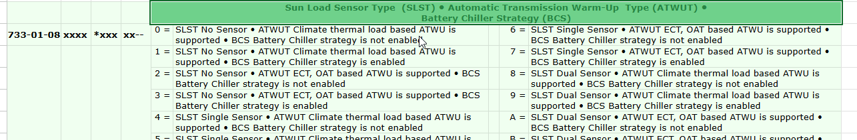
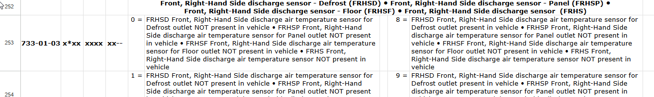
Changes I made:
Coded out solar sensors (not present on my truck, throwing codes). I went from “A” to “2”
Coded out right hand discharge temp (not present on my truck, throwing codes). I went from “6” to “0”

Slide 8
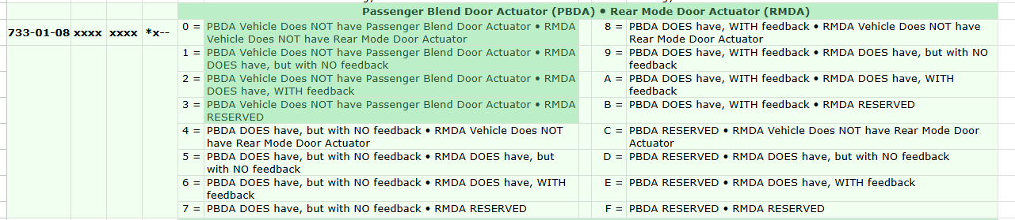
Changes I made:
Coded out damper position sensor (blend door) (not present on my truck, throwing codes). I went from “8” to “0”

Slide 9
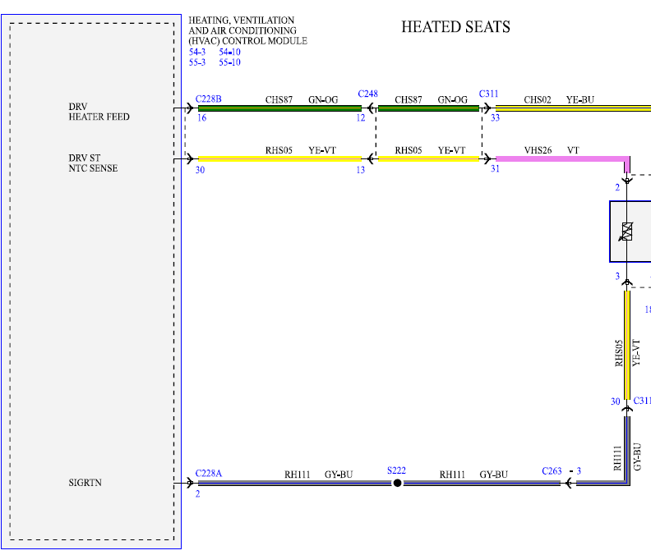
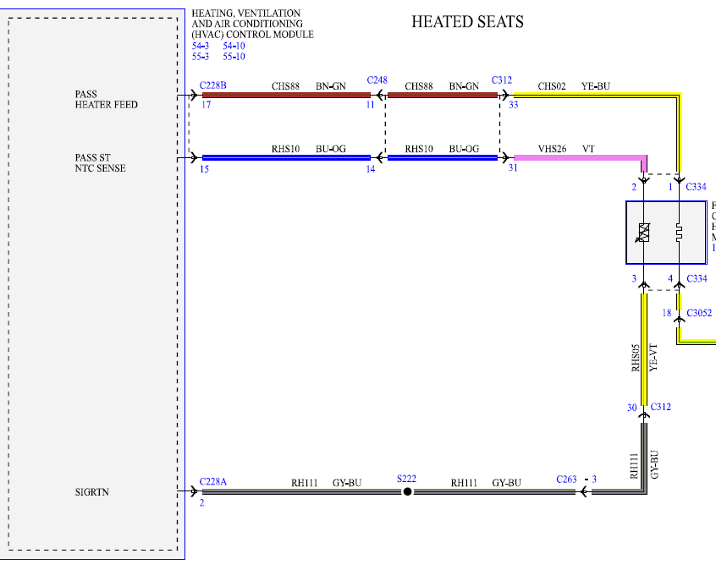
Wiring pg 1
Driver Seat:
C311 Pin 33 to C228B Pin 16 (Feed, 20g-22g)
C311 Pin 31 to C228B Pin 30 (Sensor 22g)
C311 Pin 30 to C228A Pin 2 (Splice Ref Ground)
Pass Seat:
C312 Pin 33 to C228B Pin 17 (Feed, 20g-22g)
C312 Pin 31 to C228B Pin 15 (Sensor 22g)
C312 Pin 30 to C228A Pin 2 (Splice Ref Ground)

Slide 10
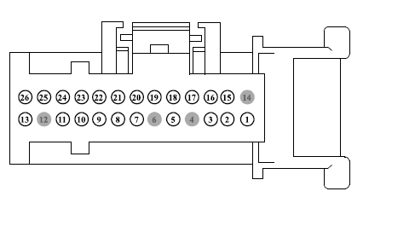
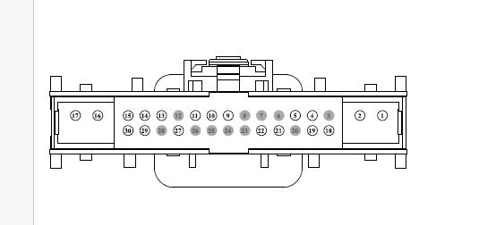
Wiring pg 2 - HVAC Side
C228 A
C228 B
Splice into C228A- pin 2 (Gray/Blue) to Pin 30 on EACH seat to maintain REF ground.
Power from your choice to Pins 1 & 2 on C228 B.
Pin 15/30 to Pass/Driver Signal
Pin 16/17 to Pass/Driver Power feed

